Slide 1
Decision Trees
Decision tree
A flow-chart-like tree structure
Internal node denotes a test on an attribute
Branch represents an outcome of the test
Leaf nodes represent class labels or class distribution

Slide 2
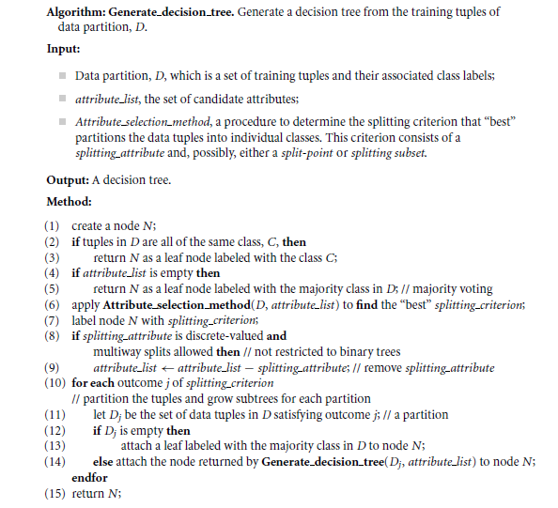

Slide 3
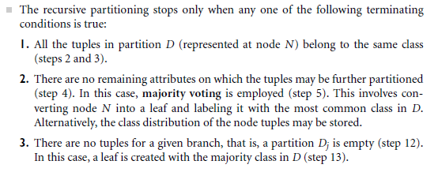
Tree Induction

Slide 4
How to Specify Test Condition?
Depends on attribute types
Nominal
Ordinal
Continuous
Depends on number of ways to split
2-way split
Multi-way split

Slide 5
Splitting Based on Nominal Attributes
Multi-way split: Use as many partitions as distinct values.
Binary split: Divides values into two subsets. Need to find optimal partitioning.
CarType
Family
Luxury
Sports
CarType
OR
CarType
{Sports, Luxury}
{Family, Luxury}
{Family}
{Sports}

Slide 6
Splitting Based on Ordinal Attributes
Multi-way split: Use as many partitions as distinct values.
Binary split: Divides values into two subsets – respects the order. Need to find optimal partitioning.
What about this split?
Size
Small
Large
Medium
Size
Size
{Small, Medium}
OR
{Medium, Large}
{Large}
{Small}
Size
{Small, Large}
{Medium}

Slide 7
Splitting Based on Continuous Attributes
Different ways of handling
Discretization
Static – discretize once at the beginning
Dynamic – ranges can be found by equal interval bucketing, equal frequency bucketing (percentiles), or clustering.
Binary Decision: (A < v) or (A ≥ v)
consider all possible splits and finds the best cut
can be more computation intensive

Slide 8
Splitting Based on Continuous Attributes

Slide 9
How to determine the Best Split
Before Splitting: 10 records of class 0, 10 records of class 1
Which test condition is the best?

Slide 10
Which Attribute is the Best Classifier?
The central choice in the ID3 algorithm is selecting which attribute to test at each node in the tree
We would like to select the attribute which is most useful for classifying examples
For this we need a good quantitative measure
For this purpose a statistical property, called information gain is used

Slide 11
Which Attribute is the Best Classifier?
Definition of Entropy
In order to define information gain precisely, we begin by defining entropy
Entropy, as it relates to machine learning, is a measure of the randomness in the information being processed
Entropy characterizes the impurity of an arbitrary collection of examples
The higher the entropy, the harder it is to draw any conclusions from that information

Slide 12
Entropy
Entropy (D)
Entropy of data set D is denoted by H(D)
C_{i} s are the possible classes
p_{i} = fraction of records from D that have class C

Slide 13
Entropy Examples
Example:
10 records have class A
20 records have class B
30 records have class C
40 records have class D
Entropy = -[(.1 log .1) + (.2 log .2) + (.3 log .3) + (.4 log .4)]
Entropy = 1.846

Slide 14
Splitting Criterion
Example:
Two classes, +/-
100 records overall (50 +s and 50 -s)
A and B are two binary attributes
Records with A=0: 48+, 2- Records with A=1: 2+, 48-
Records with B=0: 26+, 24- Records with B=1: 24+, 26-
Splitting on A is better than splitting on B
A does a good job of separating +s and -s
B does a poor job of separating +s and -s

Slide 15


Which Attribute is the Best Classifier? Information Gain
The expected information needed to classify a tuple in D is
= Entropy
How much more information would we still need (after partitioning at attribute A) to arrive at an exact classification? This amount is measured by
= H(D, A)
Info Gain (D, A) = H(D) – H(D, A)
In general, we write Gain (D, A), where D is the collection of examples & A is an attribute

Slide 16
Information Gain
Gain of an attribute split: compare the impurity of the parent node with the average impurity of the child nodes
Maximizing the gain ⇔ Minimizing the weighted average impurity measure of children nodes
ID3 uses information gain

Slide 17
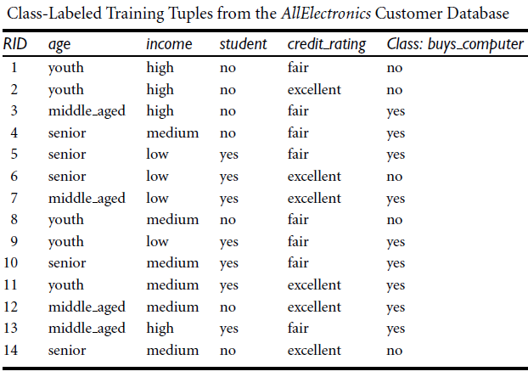





Examples Constructing Decision Tree

Slide 18
Examples Constructing Decision Tree
So the attribute Age will be placed at root level.
For placement at second level we find InfoGain for all the remaining attributes under every branch of the parent node.

